Slide 1
Quadratic Form Minimization
Summary of https://youtu.be/oaiiyIsbNdI

Slide 2

Why do we care?
Solving Ax=b is the same as solving the function:
Sparse matrix problem

Slide 3
How to fix?
Instead of solving Ax=b with gaussian elimination we minimize. Each step should reduce the size of the solution eventually yielding zero:

Slide 4
Using Derivative to Find Minima
What is the minimum value of ax^2-bx?
What is the minimum value of 1/2ax^2-bx
The connection of the minimum of 1/2ax^2-bx and Ax=b
If we find the minimum of 1/2ax^2-bx it *is* Ax=b. They’re the same!

Slide 5
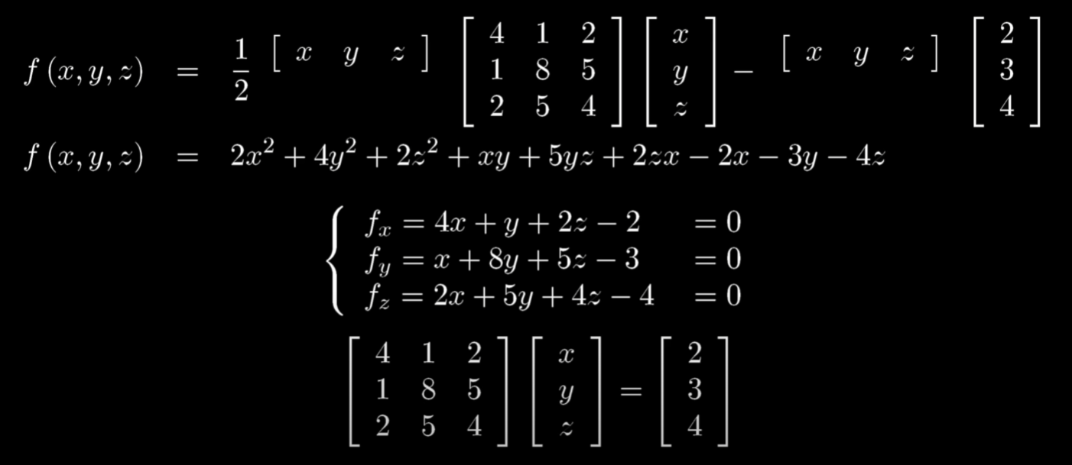
Proving the equations are the same
Notes:
Getting the source equation: https://www.wolframalpha.com/input/?i=1%2F2*%7Bx%2Cy%2Cz%7D*%7B%7B4%2C1%2C2%7D%2C%7B1%2C8%2C5%7D%2C%7B2%2C5%2C4%7D%7D*%7B%7Bx%7D%2C%7By%7D%2C%7Bz%7D%7D-%7Bx%2Cy%2Cz%7D*%7B%7B2%7D%2C%7B3%7D%2C%7B4%7D%7D
Partial differential of x: https://www.wolframalpha.com/input/?i=partial+differential+equations&assumption=%7B%22C%22%2C+%22partial+differential+equations%22%7D+-%3E+%7B%22Calculator%22%7D&assumption=%7B%22F%22%2C+%22Derivative%22%2C+%22derivativefunction%22%7D+-%3E%221%2F2*%7Bx%2Cy%2Cz%7D*%7B%7B4%2C1%2C2%7D%2C%7B1%2C8%2C5%7D%2C%7B2%2C5%2C4%7D%7D*%7B%7Bx%7D%2C%7By%7D%2C%7Bz%7D%7D-%7Bx%2Cy%2Cz%7D*%7B%7B2%7D%2C%7B3%7D%2C%7B4%7D%7D%22&assumption=%7B%22F%22%2C+%22Derivative%22%2C+%22derivativevariable%22%7D+-%3E%22x%22

Slide 6
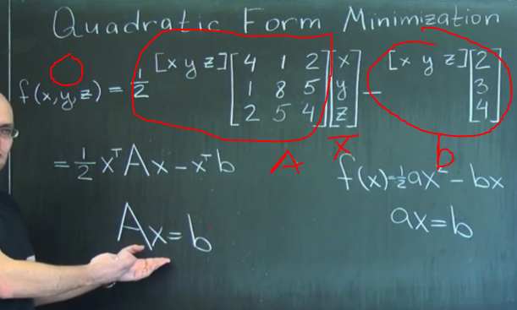
Why the same as Ax=b?

Slide 7
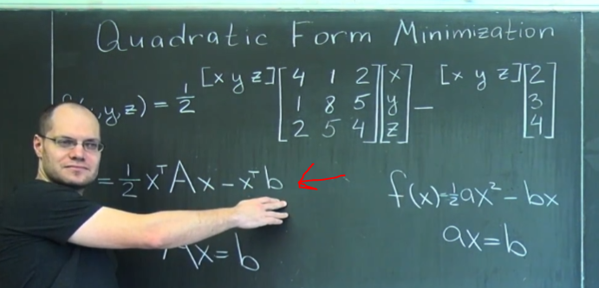
Gradient Decent
Show how gradient descent works and how it relates to this
Here the gradient is Ax. Our gradient steps will be x->x-alpha*Ax

Slide 8
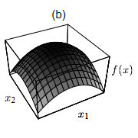
Why does it have to be positive definite/symmetric?
If it were not positive definite you could end up with stuff like:
If it weren’t symmetric then you don’t get a parabola you may get some wonky thing and instead end up finding local minimas. Proof at end of paper.

